Slide 1
Configuring Device Files
Version A.01
H3064S Module 7 Slides

Slide 2
What Is A Device File?
disks
Device
Files
6
5
4
UNIX Commands
/stand/vmunix
2
1
and Application
(Kernel)
tapes
contains references
includes software to
contains software to
to the software in
operate on hardware
terminals
operate on filenames
/stand/vmunix and
addresses which
device to access
a66920

Slide 3
Listing Device Files with ll
Listing device files with ll /dev
brw-r----- 1 root sys 31 0x005000 Feb 10 1997 /dev/dsk/c0t5d0
brw-r----- 1 root sys 31 0x006000 Feb 10 1997 /dev/dsk/c0t6d0
crw-r----- 1 root sys 31 0x005000 Feb 10 1997 /dev/rdsk/c0t5d0
crw-r----- 1 root sys 31 0x006000 Feb 10 1997 /dev/rdsk/c0t6d0
crw--w---- 2 root tty 17 0x000001 Jan 9 09:25 /dev/ttyp1
crw--w---- 2 root tty 17 0x000002 Mar 6 17:46 /dev/ttyp2
device file type
major#
minor#
device file name
a66921

Slide 4
Listing Device Files with ioscan
# ioscan -fun list all devices and device files
# ioscan -funC disk list all disk devices and device files
# ioscan -funC tape list all tape drives and device files
Class I
tape 1
H/W Path
2/0/1.1.0
Driver
stape
S/W State
CLAIMED
/dev/rmt/lm
/dev/rmt/lmb
/dev/rmt/lmn
/dev/rmt/lmnb
H/W Type
DEVICE
Description
HP C1553A
/dev/rmt/c0tld0BESTb
/dev/rmt/c0tld0BESTn
/dev/rmt/c0tld0BESTnb
/dev/rmt/c0tld0BEST
a66922

Slide 5
Listing Device Files with lssf
Lists characteristics of device files
Syntax
  /usr/sbin/lssf path [path …]
  Examples
  # lssf /dev/rdsk/clt6d0
  disc3 card instance 1 SCSI target 6 SCSI LUN 0
  section 0 at address 52.6.0 /dev/rdsk/clt6d0
  # lssf /dev/rmt/0mn
  tape2 card instance 1 SCSI target 0 SCSI LUN 0 at&t no rewind best density available at address 52.0.0 /dev/rmt/0mn
a6974

Slide 6
The Layout of /dev
/
dev
dsk
rdsk
rmt
ttyxpy
ttydxpx
•
•
•
•
•
•
•
•
•
Terminals
Modems
Disk Drives
Tape Drives
a66924

Slide 7
Device File Naming Convention
c#t#d#[other]
Instance number of the
interface card
SCSI target address
Device number
Device-dependent
information
a66925

Slide 8
Disk Device File Names
Server
SCSI
Card
I = 0
Disk A
Disk B
Target 6
Target 5
SCSI
Card
I = 1
CDROM D
Disk C
Target 6
Target 4
/dev/dsk/c#t#d#
/dev/rdsk/c#t#d#
a66926

Slide 9
Tape Device File Names
Server
SCSI Card I = 0
Tape A
Target 0
SCSI
Card
I = 1
Tape B
Target 0
/dev/rmt/c#t#d#[access options]
a66927

Slide 10

Terminal and Modem Device File Names
MUX
Card
I=0
MUX Panel
Terminal
0 7
1 6
2 5
3 4
Modem
MUX
Card
I=1
MUX Panel
Terminal
0 7
1 6
2 5
3 4
/dev/tty#p#
Modem
a66928

Slide 11
How Device Files are Created
Autoconfiguration
SAM
insf
mksf
mknod
a53815

Slide 12
Autoconfiguration
/etc/ioconfig
Mapping between Hardware
Path and major/minor, device
class, instance number
insf
Kernel I/O
tree
Device Files
/dev
a53818

Slide 13
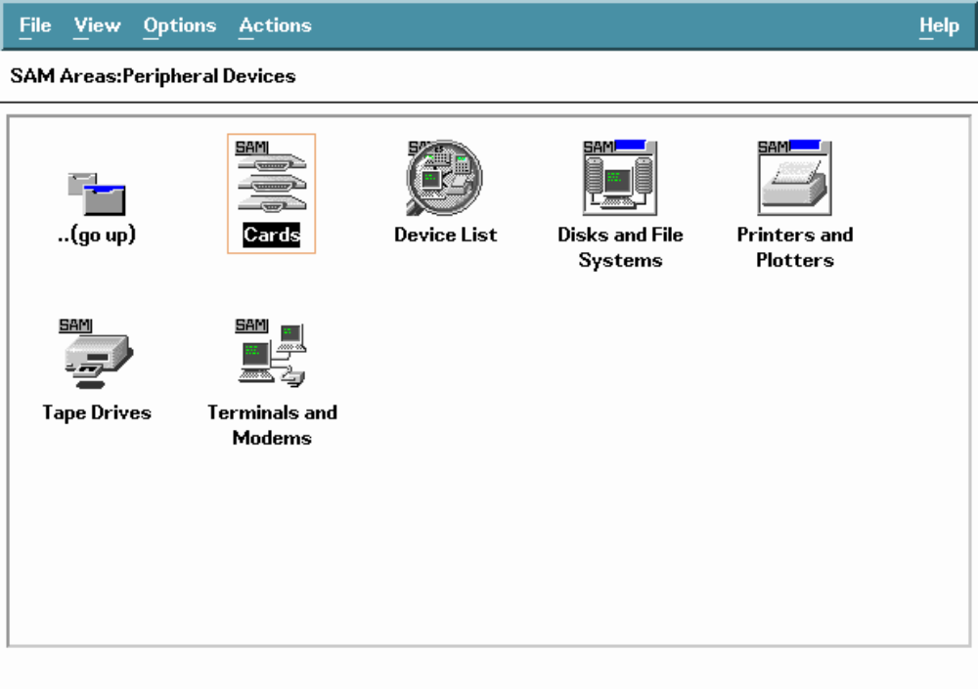
Creating Device Files with SAM
a53816

